Slide 1

Essentials of Economics
Seventh Edition
Chapter 15
Aggregate Demand and Aggregate Supply Analysis
Copyright © 2021, 2019, 2017 Pearson Education, Inc. All Rights Reserved.
Notes:
If this PowerPoint presentation contains mathematical equations, you may need to check that your computer has the following installed:
1) MathType Plugin
2) Math Player (free versions available)
3) NVDA Reader (free versions available)

Slide 2
Aggregate Demand and Aggregate Supply Model
We have now modeled long-run economic growth and also how real G D P is determined in the short run.
New goal: extend the model of the economy in the short run in order to explain why the following fluctuate:
Real G D P
Employment
The price level
New model: Aggregate demand and aggregate supply model, a model that explains short-run fluctuations in real G D P and the price level.

Slide 3
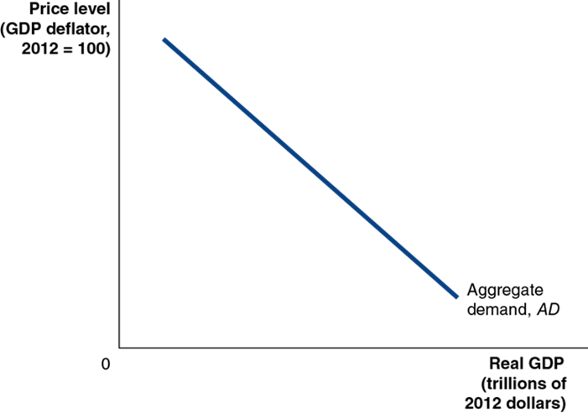
Figure 15.1 Aggregate Demand and Aggregate Supply (1 of 3)
In the short run, real G D P and the price level are determined by the intersection of the aggregate demand curve…
Aggregate demand (A D) curve: A curve that shows the relationship between the price level and the quantity of real G D P demanded by households, firms, and the government (both inside and outside of the country).
Notes:
Note: Slide 3 of 3 on Figure 15.1 will appear on slide 11.

Slide 4
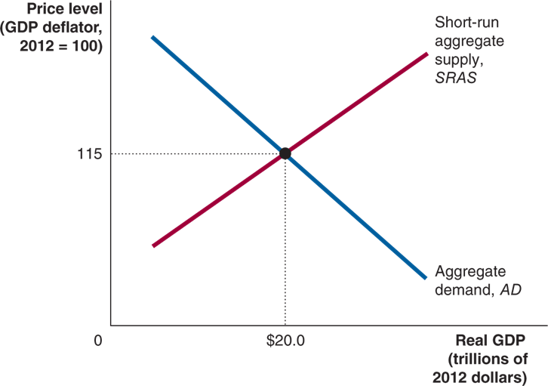
Figure 15.1 Aggregate Demand and Aggregate Supply (2 of 3)
…and the short-run aggregate supply curve.
Short-run aggregate supply (S R A S) curve: A curve that shows the relationship in the short run between the price level and the quantity of real G D P supplied by firms.
Notes:
Note: Slide 3 of 3 on Figure 15.1 will appear on slide 11.
The X axis represents real G D P, Y, in trillions of 2012 dollars, and the Y axis represents price level with the G D P deflator where 2012 = 100. The short run aggregate supply, S R A S line rises through the graph, and the aggregate demand, A D falls through the graph. The lines intersect at (20.0, 115).

Slide 5

Figure 15.1 Aggregate Demand and Aggregate Supply (3 of 3)
Each of the three effects show higher price levels leading to lower values of components of real G D P.
This establishes that the aggregate demand curve slopes downward.

Slide 6
The Wealth Effect: How a Change in the Price Level Affects Consumption
Household consumption is most strongly determined by income, but it is also affected by wealth.
Some household wealth is held in nominal assets, so as price levels rise, the real value of household wealth declines. This results in less consumption.
Implication: higher price level leads to lower consumption.

Slide 7
The Interest-Rate Effect: How a Change in the Price Level Affects Investment
When prices rise, households and firms need more money to finance buying and selling.
So, households and firms borrow and withdraw funds from banks and sell financial assets such as bonds in order to have more funds available.
This increase in demand for money causes the “price” of holding money (the interest rate) to rise, discouraging firm investment.
Implication: higher price level leads to lower investment.

Slide 8
Shifts of the Aggregate Demand Curve versus Movements Along It
The aggregate demand curve shows the relationship between the price level and real G D P demanded, holding everything else constant.
A movement along the A D curve will occur when the price level changes, and the change in prices is not caused by a component of real G D P changing.
A shift of the A D curve will occur when some component of real G D P changes; for example, a change in government purchases.

Slide 9
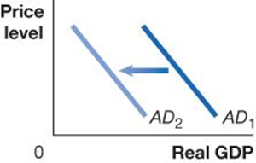
Table 15.1 Variables That Shift the Aggregate Demand Curve (1 of 4)
An increase in … | shifts the aggregate demand curve … | because …
interest rates | On a graph, X is real G D P, and Y is price level. Line A D sub 1 shifts left and becomes A D sub 2. | higher interest rates raise the cost to households and firms of borrowing, reducing consumption and investment spending.
A government policy change could shift aggregate demand. There are two categories of government policies here:
Monetary policy: The actions the Federal Reserve takes to manage the money supply and interest rates to pursue macroeconomic policy objectives.
If the Federal Reserve causes interest rates to rise, investment spending will fall; if it causes interest rates to fall, investment spending will rise.

Slide 10
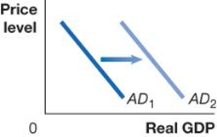
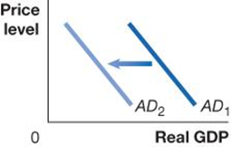
Table 15.1 Variables That Shift the Aggregate Demand Curve (2 of 4)
An increase in … | shifts the aggregate demand curve … | because …
government purchases | On a graph, X is real G D P, and Y is price level. Line A D sub 1 shifts right and becomes A D sub 2. | government purchases are a component of aggregate demand.
personal income taxes or business taxes | On a graph, X is real G D P, and Y is price level. Line A D sub 1 shifts left and becomes A D sub 2. | consumption spending falls when personal taxes rise, and investment falls when business taxes rise.
Fiscal policy: Changes in federal taxes and purchases that are intended to achieve macroeconomic policy objectives.
Increasing or decreasing personal income taxes affects disposable income and hence consumption. The government can also alter its level of government purchases. It could also alter business taxes, affecting the level of investment spending.

Slide 11
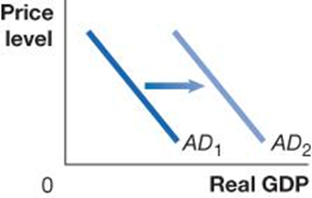

Table 15.1 Variables That Shift the Aggregate Demand Curve (3 of 4)
An increase in … | shifts the aggregate demand curve … | because …
households’ expectations of their future incomes | On a graph, X is real G D P, and Y is price level. Line A D sub 1 shifts right and becomes A D sub 2. | consumption spending and the residential investment component of investment spending increase.
firms’ expectations of the future profitability of investment spending | On a graph, X is real G D P, and Y is price level. Line A D sub 1 shifts right and becomes A D sub 2. | investment spending increases.
Households or firms could become more optimistic about the future, increasing consumption or investment respectively.
Of course, the opposite could also occur.

Slide 12
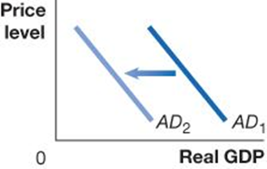

Table 15.1 Variables That Shift the Aggregate Demand Curve (4 of 4)
An increase in … | shifts the aggregate demand curve … | because …
the growth rate of domestic G D P relative to the growth rate of foreign G D P | On a graph, X is real G D P, and Y is price level. Line A D sub 1 shifts left and becomes A D sub 2. | imports will increase faster than exports, reducing net exports.
the exchange rate (the value of the dollar) relative to foreign currencies | On a graph, X is real G D P, and Y is price level. Line A D sub 1 shifts left and becomes A D sub 2. | imports will rise and exports will fall, reducing net exports.
If foreign incomes rise more slowly than ours, their imports of our goods fall; if ours rise more slowly, our imports fall.
If our exchange rate (the value of the $U S) rises, our exports become more expensive, so foreigners buy less of them (and we buy more imports, also).

Slide 13
15.2 Aggregate Supply
Identify the determinants of aggregate supply and distinguish between a movement along the short-run aggregate supply curve and a shift of the curve.
Aggregate supply refers to the quantity of goods and services that firms are willing and able to supply.
The relationship between this quantity and the price level is different in the long and short run.
So, we will develop both a short-run and long-run aggregate supply curve.
Long-run aggregate supply (L R A S) curve: A curve that shows the relationship in the long run between the price level and the quantity of real G D P supplied.

Slide 14
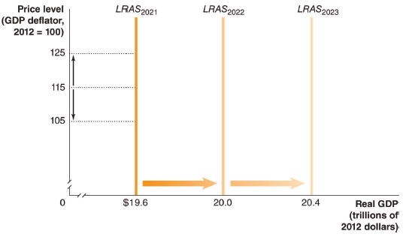
Figure 15.2 The Long-Run Aggregate Supply Curve
In the long run, the level of real G D P is determined by the number of workers, the level of technology, and the capital stock (factories, machinery, etc.).
None of these elements is affected by the price level, so L R A S does not depend on the price level; it is a vertical line.
L R AS occurs at the level of potential or full-employment G D P, which advances each year.
Notes:
On the truncated graph, the X axis represents real G D P, in trillions of 2012 dollars, and the Y axis represents price level with G D P deflator of 100 for 2012. The vertical line L R A S sub 2021 at 19.6 shifts right and becomes L R A S sub 2022 at 20.0, and shifts right again to become L R A S sub 2023 at 20.4.

Slide 15
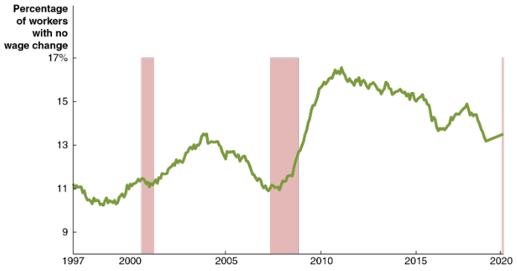
Apply the Concept: How Sticky Are Wages?
It is unclear how sticky wages are. There is good evidence that wages are at least sticky downward.
Instead of cutting (nominal) wages, firms tend to fire current workers, freeze pay, and offer lower salaries to new workers. This “gets misery out of the door.”
The graph shows the percentage of workers with no wage change in a given year.
Notes:
NOTE: In the digital chapter, This figure is an interactive real-time data graph, which means it automatically updates when new data becomes available.
The graph plots percentage of workers with no wage change versus year from 1997 through 2020. The plot rises and falls irregularly across the graph with the following general trend. It falls from 11.22% in August 1997 to 10.24 in March 1999, rises to 15.51% in August 2004, falls to 10.90% in November 2007, rises to 16.56% in September 2011, then falls to 15.51% in March 2020.

Slide 16
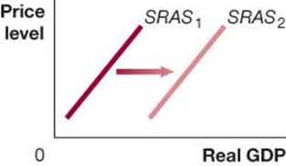

Table 15.2 Variables That Shift the Short-Run Aggregate Supply Curve (1 of 3)
An increase in … | shifts the short-run aggregate supply curve … | because …
the labor force or the capital stock | On a graph, X is real G D P, and Y is price level. Line S R A S sub 1 shifts right and becomes S R A S sub 2. | more output can be produced at every price level.
productivity | On a graph, X is real G D P, and Y is price level. Line S R A S sub 1 shifts right and becomes S R A S sub 2. | costs of producing output fall.
An increase in the availability of the factors of production, i.e. labor and capital, allows more production at any price level.
A decrease in the availability of these factors decreases S R A S.
Improvements in technology allow productivity to improve, and hence the level of production at any given price level.

Slide 17
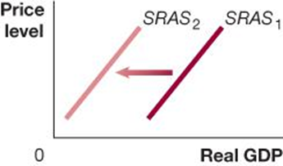

Table 15.2 Variables That Shift the Short-Run Aggregate Supply Curve (2 of 3)
An increase in … | shifts the short-run aggregate supply curve … | because …
the expected future price level | On a graph, X is real G D P, and Y is price level. Line S R A S sub 1 shifts left and becomes S R A S sub 2. | expecting the price level to increase leads workers and firms to increase wages and prices.
workers and firms adjusting to having previously underestimated the price level | On a graph, X is real G D P, and Y is price level. Line S R A S sub 1 shifts left and becomes S R A S sub 2. | workers and firms attempt to catch up to a higher price level by increasing wages and prices.
If workers and firms expect higher prices in the future, S R A S shifts to the left. This could happen because:
Inflation expectations increase or
Workers and firms realize they previously underestimated the price level.

Slide 18
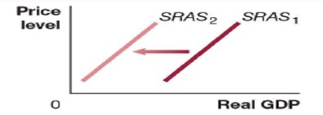
Table 15.2 Variables That Shift the Short-Run Aggregate Supply Curve (3 of 3)
An increase in … | shifts the short-run aggregate supply curve … | because …
the price of an important natural resource or the occurrence of a natural disaster or pandemic. | On a graph, X is real G D P, and Y is price level. Line S R A S sub 1 shifts left and becomes S R A S sub 2. | costs of producing output rise or many firms are forced to temporarily close.
A supply shock is an unexpected event that causes the short-run aggregate supply curve to shift.
Examples: Oil prices increase suddenly. Firms immediately anticipate rising input prices and will only produce the same amount of output if their own prices rise. The pandemic shutdown closed businesses and reduced supply in 2020.
Unexpected input price increases cause a decrease in the S R A S; unexpected input price decreases would shift S R A S to the right instead.

Slide 19
15.4 A Dynamic Aggregate Demand and Aggregate Supply Model
Use the dynamic aggregate demand and aggregate supply model to analyze macroeconomic conditions.
Our model of aggregate demand and aggregate supply so far has been static, in the sense that:
Price levels were constant (no inflation)
There was no long-run growth
We will now form a dynamic aggregate demand and aggregate supply model, incorporating:
Continually increasing real G D P, shifting L R A S to the right
A D also ordinarily shifting to the right
S R A S shifting to the right, except when workers and firms expect high rates of inflation

Slide 20
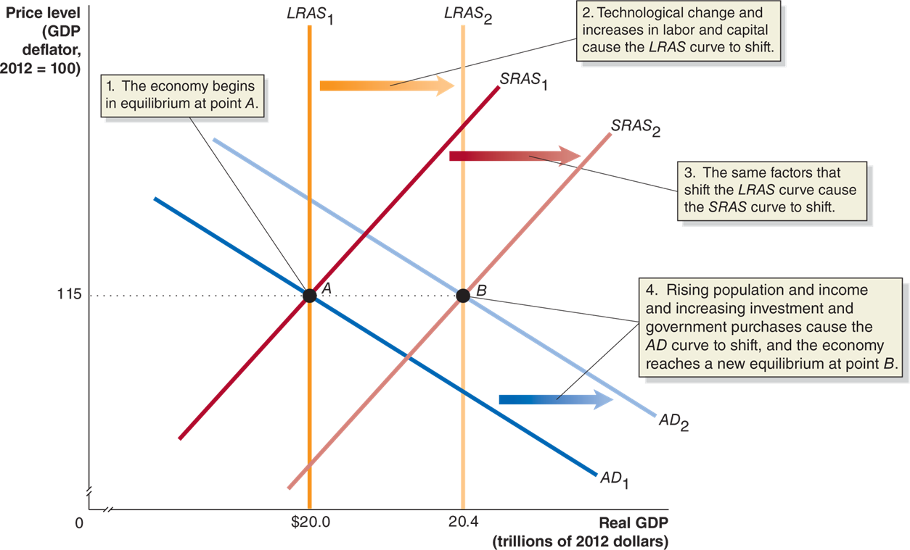
Figure 15.9 A Dynamic Aggregate Demand and Aggregate Supply Model
Notes:
On the truncated graph, the X axis represents real G D P, Y, in trillions of 2012 dollars, and the Y axis represents price level with a G D P deflator, when 2012 = 100. Line A D sub 1 shifts right and becomes A D sub 2. Vertical line L R A S sub 1, S R A S sub 1, and A D sub 1 all intersect at point A, (20.0, 115). The economy begins in equilibrium at point A. Vertical line L R A S sub 1 shifts right and becomes vertical line L R A S sub 2. Technological change and increase in labor and capital cause the L R A S curve to shift. S R A S sub 1 shifts right, and becomes S R A S sub 2, the same factors that shift the L R A S curve causes the S R A S curve to shift. L R A S sub 2, S R A S sub 2, and A D sub 2 intersect at point B, (20.4, 115). Rising population and income and increasing investment and government purchases cause the A D curve to shift, and the economy reaches a new equilibrium at point B.

Slide 21
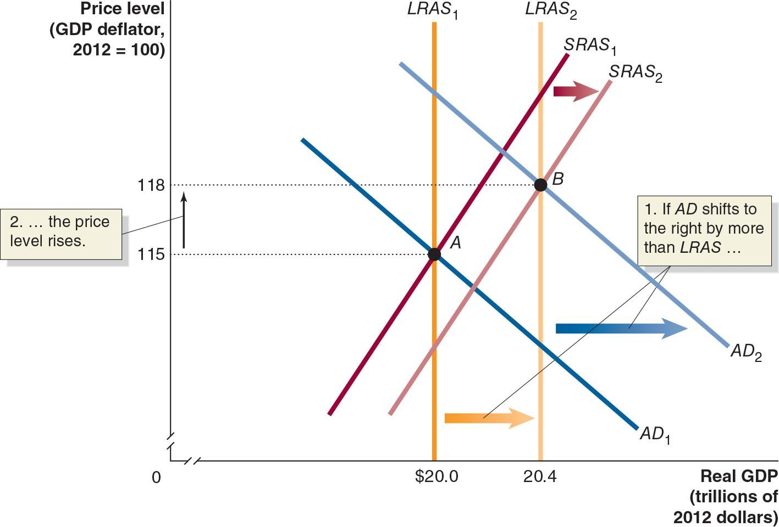
Figure 15.10 Using Dynamic Aggregate Demand and Aggregate Supply to Understand Inflation
The usual cause of inflation is total spending increasing faster than production.
A D moves further right than does L R A S.
S R A S moves to the right; but the anticipated rise in the price level causes it to shift less than L R A S.
Long-run equilibrium is restored but with a higher price level.
Notes:
On the truncated graph, the X axis represents real G D P, in trillions of 2012 dollars, and the Y axis represents price level with a G D P deflator, when 2012 = 100. Line A D sub 1 shifts right and becomes A D sub 2. Vertical line L R A S sub 1 shifts right and becomes L R A S sub 2. If A D shifts more to the right than L R A S, then the price level rises. Line S R A S sub 1 shifts right and becomes S R A S sub 2. Lines L R A S sub 1, A D sub 1 and S R A S sub 1 intersect at point A, (20.0, 115). Lines L R A S sub 2, A D sub 2, and S R A S sub 2 intersect at point B, (20.4, 118).

Slide 22
Main Factors Causing the Recession of 2007-2009
The end of the housing bubble
House prices rose in the early 2000s—initially due to low interest rates, but then due to speculation. In 2006, the speculative bubble began to deflate, and the spending on residential investment fell.
The 2007 – 2009 financial crisis
As many people defaulted on their mortgages, many financial institutions took heavy losses. This financial crisis led to a credit crunch, decreasing consumption and investment spending.
The rapid increase in oil prices during 2008
Several factors combined to increase the price of oil from $34 per barrel in 2004 to $140 per barrel in mid-2008. This supply shock exacerbated the ongoing recession.

Slide 23
Appendix: Macroeconomic Schools of Thought
Compare macroeconomic schools of thought.
Macroeconomic theory is relatively less settled than microeconomic theory.
Macroeconomics developed as a separate field within economics after the Great Depression.
John Maynard Keynes’ 19 36 book The General Theory of Employment, Interest, and Money inspires the model we have addressed in this chapter.
Widespread acceptance during the 19 30s and 19 40s of Keynes’ model became known as the Keynesian revolution.

Slide 24
New Keynesian Economics
Modern followers of Keynes refer to themselves as new Keynesians.
Emphasize the stickiness of wages and prices in explaining fluctuations in real G D P—a concept that Keynes did not include in his original model.

Slide 25
The Monetarist Model
Monetarism refers to the macroeconomic theories of Milton Friedman and his followers, particularly the idea that the quantity of money should be increased at a constant rate.
Friedman argued in the 19 40s that most fluctuations in real output were caused by fluctuations in the money supply.
Therefore, the Federal Reserve should concentrate less on interest rates and more on following a monetary growth rule, a plan for increasing the quantity of money at a fixed rate that does not respond to changes in economic conditions.
Monetarism is based on the quantity theory of money, which we’ll examine in the next chapter.

Slide 26
The New Classical Model
New classical macroeconomics emerged in the 1970s; it consists of the macroeconomic theories of Robert Lucas and others, particularly the idea that workers and firms have rational expectations.
In the new classical school of thought, workers and firms develop expectations about price levels. If these expectations are wrong, then the real wage will be too high or too low, causing firms to reduce or increase employment respectively—recession or expansion.
New classical economists believe these fluctuations can be minimized by helping workers and firms to form correct expectations—again, a consistent monetary growth rule.

Slide 27
The Real Business Cycle Model
The real business cycle model of the economy focuses on real, rather than monetary, causes of the business cycle.
Adherents to this model also believe that workers and firms form rational expectations about prices and wages, which adjust quickly to supply and demand.
But they argue that the main sources of fluctuations in real G D P are temporary productivity shocks.
They maintain that aggregate supply is vertical even in the short run, unaffected by the price level. It is supply shocks that affect the level of real output.

Slide 28
The Austrian Model (1 of 2)
The Austrian school of economics:
Began in the late nineteenth century with the writings of Carl Menger.
Was advanced by Ludwig von Mises and Friedrich von Hayek.
The Austrian school argues for the superiority of the market system over economic planning.
Hayek particularly argued that only the price system could use all the dispersed information to achieve efficiency.

Slide 29
The Austrian Model (2 of 2)
Hayek also developed a theory of the business cycle, wherein central bank-induced low interest rates cause the business cycle by prompting overinvestment.
Austrians argue the 2007-2009 recession fits this model. They claim the Fed cut interest rates too low in fighting the 2001 recession.

Slide 30
Which School of Thought Is Correct?
To date, we do not know which school of thought is correct about the economy.
Many pieces of evidence can be interpreted in several different ways.
Economists cannot isolate particular elements to study and conduct controlled experiments.
So, it is likely that debate about the applicability of schools of thought, and hence optimal policies for governments to pursue, will continue for the foreseeable future.

Slide 31

Copyright
This work is protected by United States copyright laws and is provided solely for the use of instructors in teaching their courses and assessing student learning. Dissemination or sale of any part of this work (including on the World Wide Web) will destroy the integrity of the work and is not permitted. The work and materials from it should never be made available to students except by instructors using the accompanying text in their classes. All recipients of this work are expected to abide by these restrictions and to honor the intended pedagogical purposes and the needs of other instructors who rely on these materials.

